Slide 1
Study: Data Scientist Decision Making
Vinzent Müller
Oct 24th 2018

Slide 2
Overview
Subject of study: Out of Stock Dashboard
Problem statement
Process
Conclusion

Slide 3
Problem: Out of Stock Items
Lost revenue
Negative user experience on website
OKR goal of purchasing & PM department
  Quantify possible reduction!
Reportable to CEO

Slide 4
Problem: Out of Stock Items
Involved Parties
  Purchasing team
  Product Management team
  Operations & Logistics
Prelude
  First mention: JF with head of BI
  Personal meeting with head of purchasing
  Kick-off meeting with all parties

Slide 5
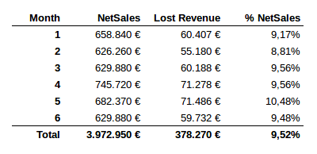
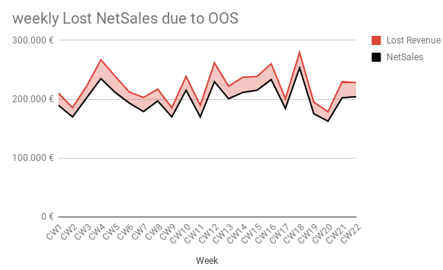
Kick-off
Use information gathered in preliminary meetings to create case for suggested actions
People are aware of the problem, but no quantification!

Slide 6
Kick-off
Proposal: Power BI dashboard
  Decide on list of metrics for first iteration
  Per item: days OOS, lost NS, previous NS, delivery delay, # Orders
  ‘appropriate visualisations’
  presentable in one week
  QA review sessions with purchasing
Weekly incremental development
  Goal #1: Inform OKR goals
  Goal #2: Improve purchasing process

Slide 7
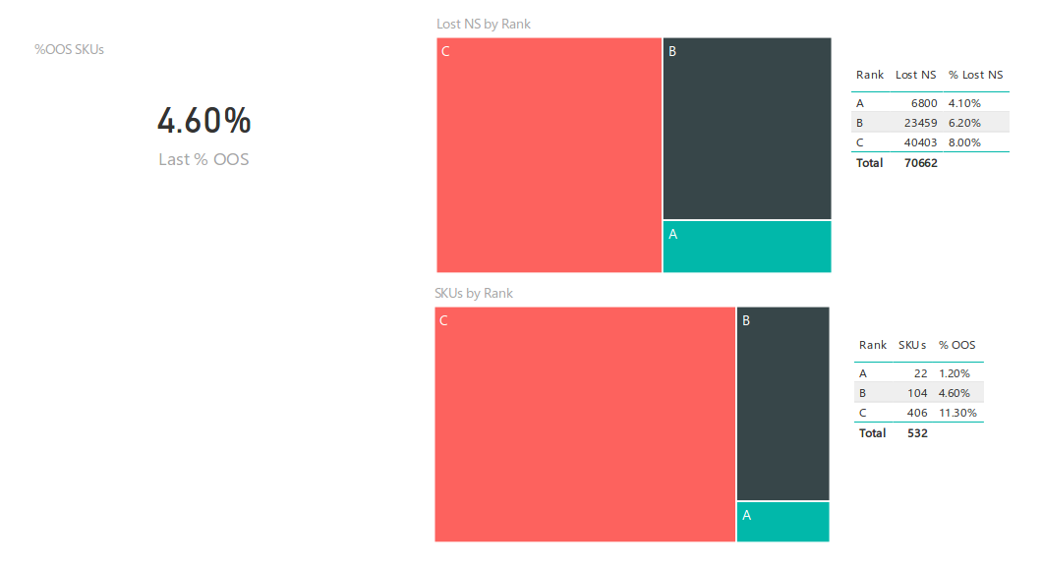
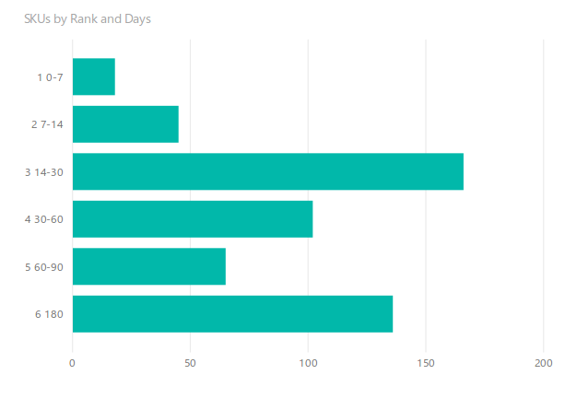
Review Sessions
1st session: review MVP
  Minor glitches in calculations, some nominal data requested
  Review session + 1D: product is usable
  Ideas rolling in: “We have that metric in that file...”

Slide 8
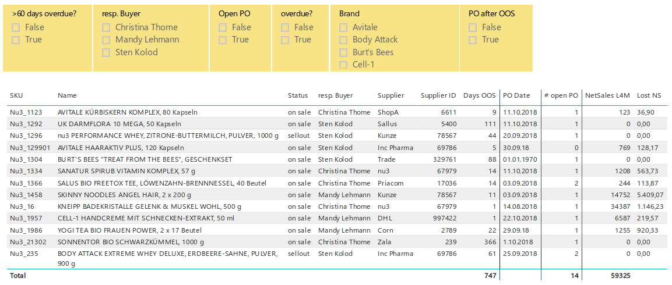
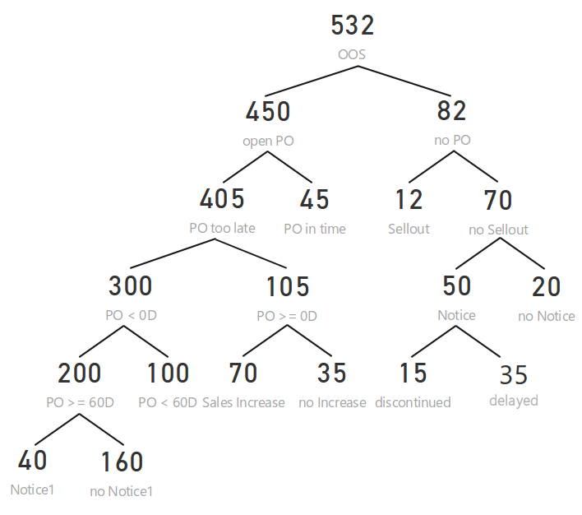
Review Sessions
Final report: decision tree filter

Slide 9
Conclusion
Explained OOS composition
  Enables buyers to formulate processes for critical subgroups
OKR goals fixed OOS reduction to 8 %
Historized dashboard data allows tracking of improvements

